Slide 1

Introduction of IoT Solutions
Seiko Electric Co., Ltd.
17October,2017

Slide 2
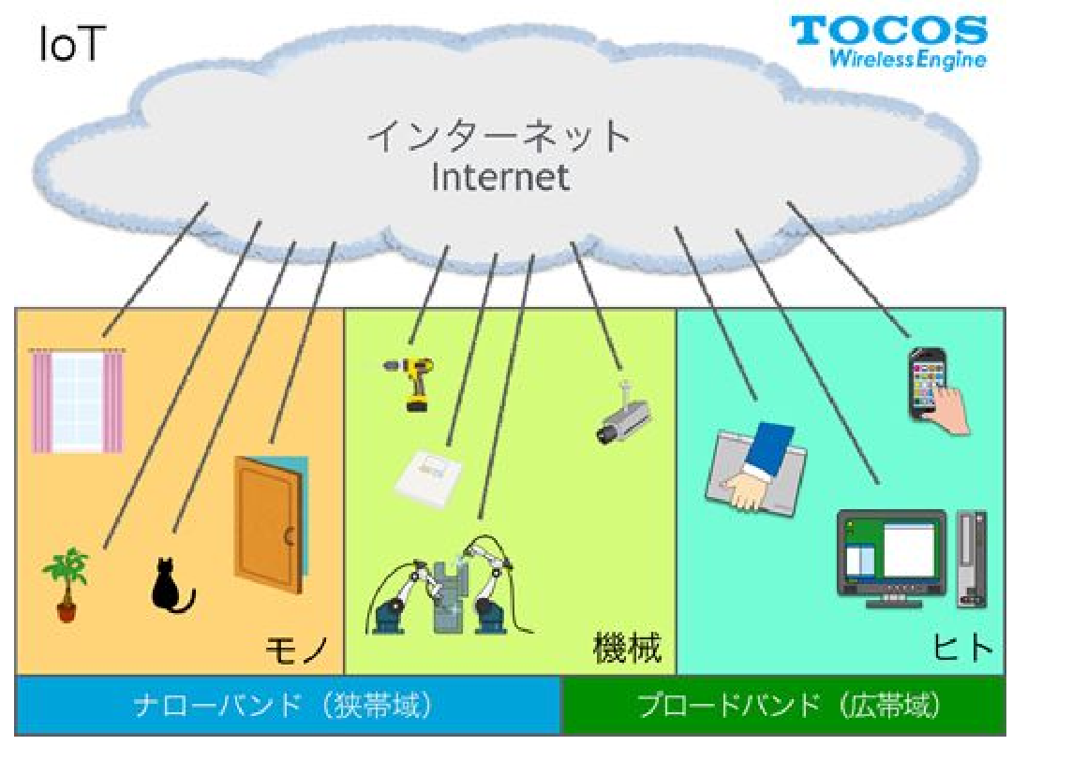


What’s RFID?
-RFID(Radio Frequency Identification) is technology to read/write RFID Tag(IC Tag) with contactless using Radio wave.
We provide the solutions with RFID Technology to prevent human errors and for productivity improvement.
RFID Technology

Slide 3
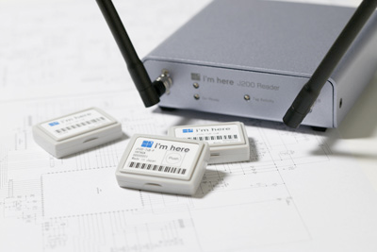

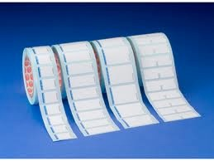
Type (1) of IC Tag
Item | Passive Tag | Active Tag
Feature | Work by radio from leader as energy source .(Without battery) | Work by the battery as electromotive force.
Communication range | Read it at distance of several meters | Read it at distance of more than Several hundred meters
Price range | Tens Yen to Hundreds(Inlet type price) | Several hundreds of thousand(Target a few pcs)
Other (Semi Active Tag) :This tag is utilized the merit of Passive Tag/Active Tag.
Start-up like Passive tag , Communication like Active tag.

Slide 4
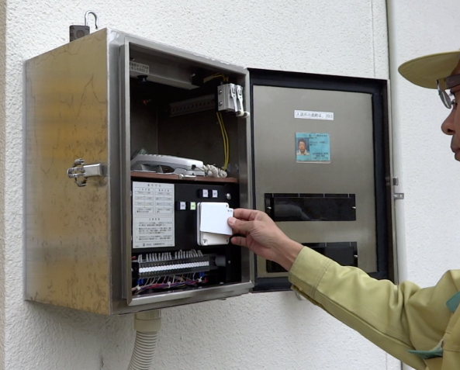
Type (2) of IC Tag
Frequency band | 900MHz～5GHz | 135kHz～433MHz
Method | Radio wave type | Inductive coupling type
Use | Metallic tag (μ-chip),tag of rice size | Felica etc.
Communication distance | Having relatively long. Several meters | Having relatively short. Tens cm
Reading speed | Fast | Slightly slow compared with the left side.
Shape of tag | Small to middle size | Large size
Remarks
Change electric power from radio energy
Radio is liner. Dipole, Patch antenna
->Difficult to change the shape of antenna
Get electric power from a magnetic field. Communication area is wide.
Loop antenna->Need to adjust the shape of antenna
Tag with 2.4GHz is utilized by Seiko Products :Operation supporting system.
Seiko Products :Gate Control System with Felica(contactless).

Slide 5
Difference between IC Tag and Barcode(QR)
Item | IC Tag | Barcode(QR)
Reading range | Able to adjust scope of reader. For direction of reader, it is adjustable and easy to read. | Scope is narrow. If not fix, it is hard to read it.
Shape | Variety of type(Small type/flat type etc.) Note: There are type of Rice size , Sand size | Needs a certain size.(approximate 2cm )
Reading data size | Read huge data all at once | Need to read separately
Storing of information | Possible to write information in a memory of Tag. | Impossible to write information.
Environment | Able to read it with dirty and use it on variety of environment. | Need to see stripe pattern clearly. For seal, easy to deteriorate and weak for change of environments.
Life time | Generally ten years(Note1) | Depend on life time of seal
Price | Number ten Yen to Several hundred Yen (Inlet price) | Make it myself.(expanses for seal only)
Note: We have 18 years experience to use Tag for our operation supporting system.

Slide 6
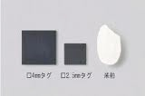
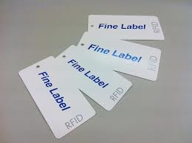
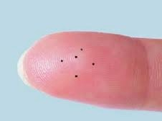
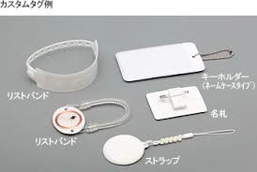
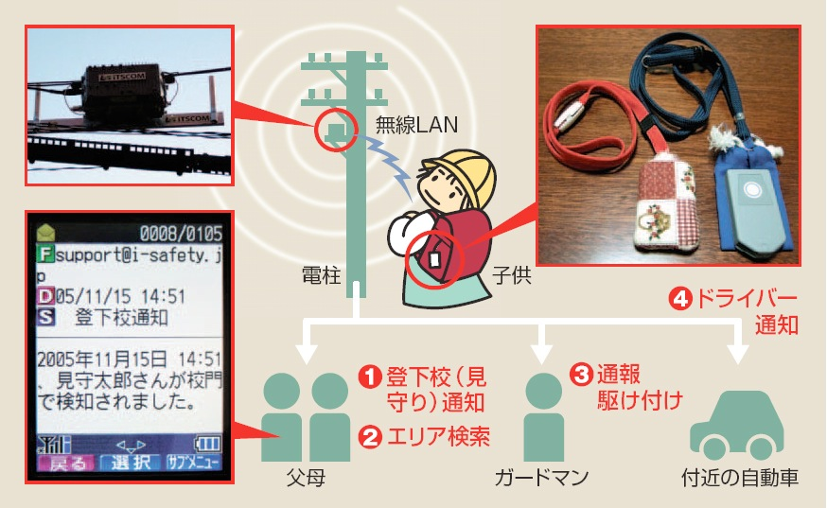
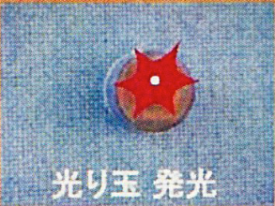
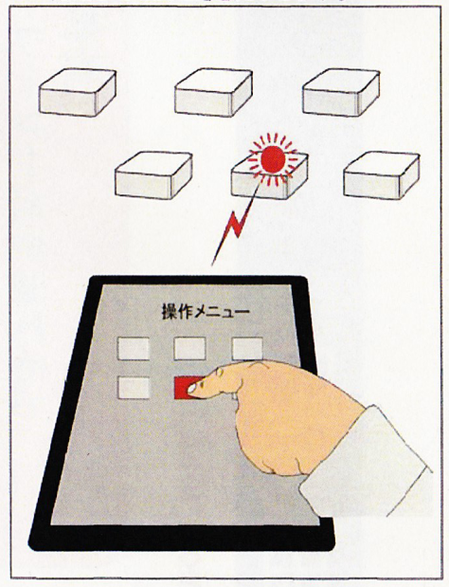
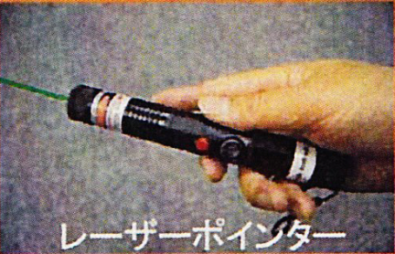
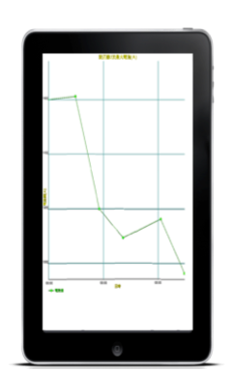
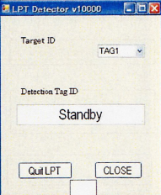
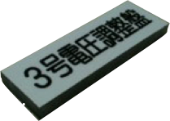
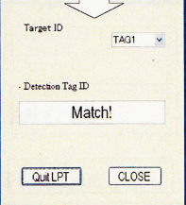
Various IC Tag
Seal type Tag
Rice type Tag
Metallic type tag
Card type tag
Sand type Tag
Use by Operation Supporting System
99V
Ex) Processed Tag
23A
When select tag on tablet, tag will be flashed.
“Hikaridama” Tag
Use by Operation Supporting System
“Hikaridama “Tag

Slide 7
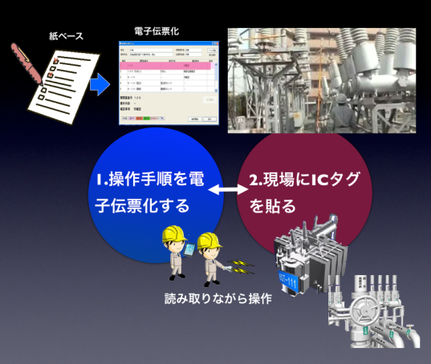
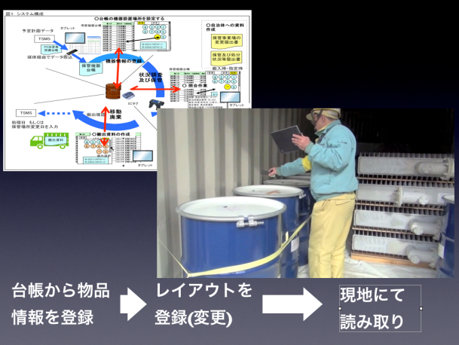
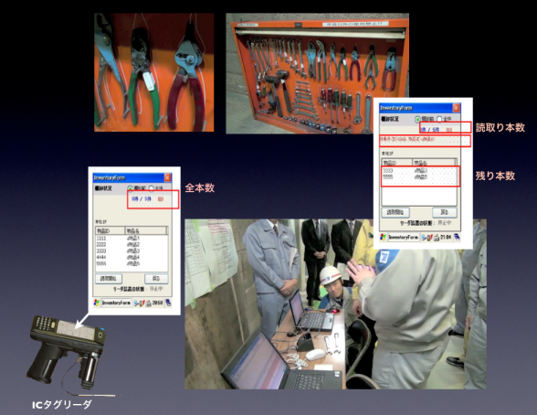
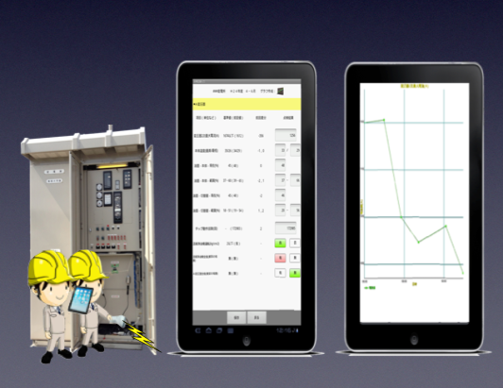
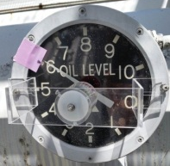
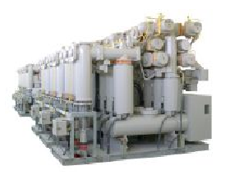
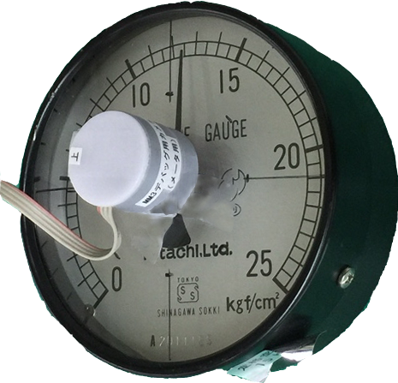
Maintenance operation supporting System
６.RFIDを使用したシステム事例
IoT Solutions
Inventory Control System
Tool Management System
Maintenance inspection System
Utilization of RFID technology

Slide 8
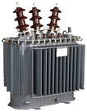



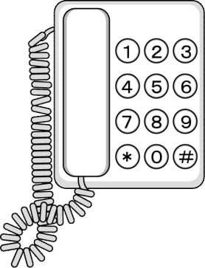

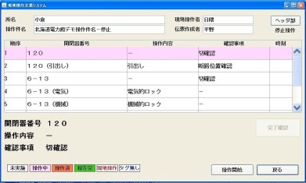



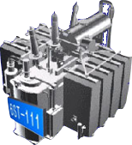


Operation & Maintenance supporting System
Implemented all substations for one of power grid company in Japan.
(Current)
Prepare instruction sheet by EXCEL.
Operations on site
Work based on instruction sheet on paper
After check current instruction on paper, go to next.
Report by the phone
(After implementation)
1. Prevention for misrecognition of equipment
2. Prevention for wrong operation procedure
3.Prevention for leaving tools
4.Easy Reports
e-slip
Download
Operations on site
Work based on e-slip with tablet.
-Collectively report by LAN
-Report by Wireless LAN in real time.
After reading tags, go to next.

Slide 9
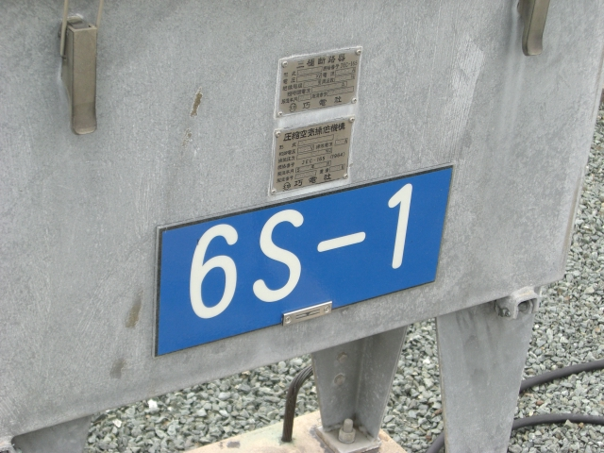
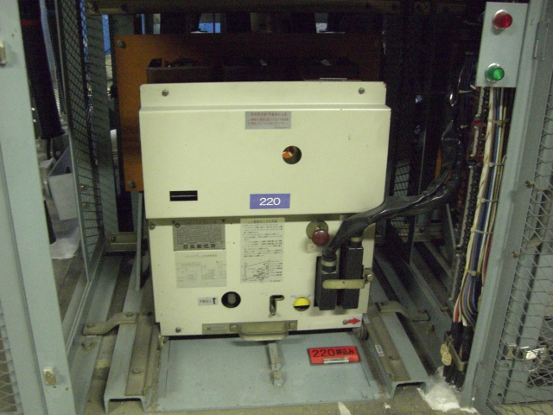
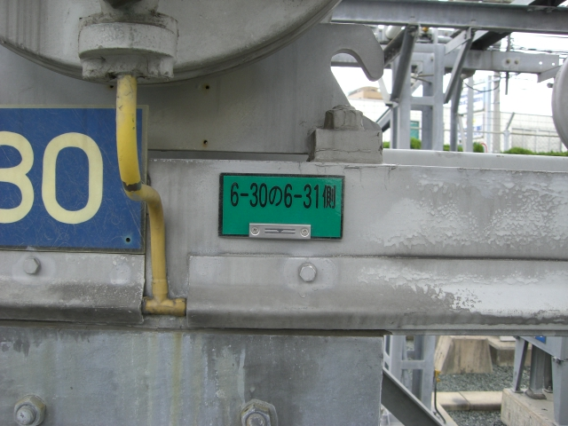
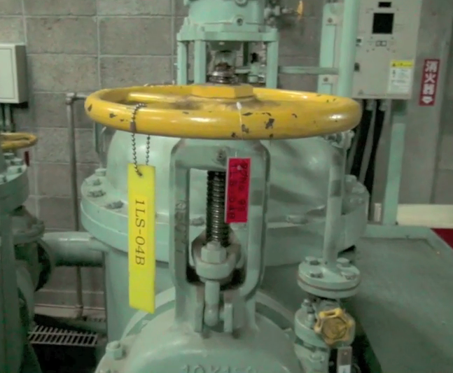
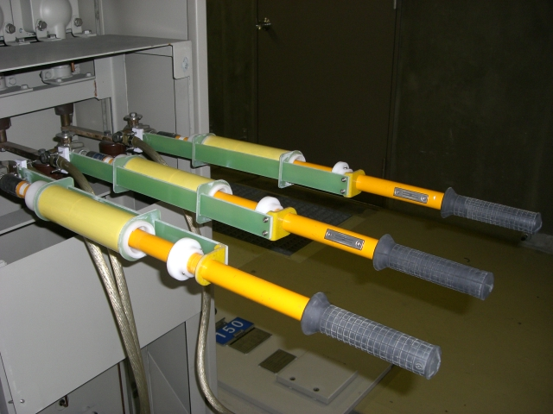
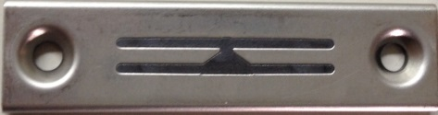
Role of IC Tag that is installed to equipment on site
Identification of equipment
Guide to location
Instruction
Point that check electric
Point that ground
Confirm draw process
Confirm push process
Metallic ICTag
Tag for ground
Put on nameplate

Slide 10
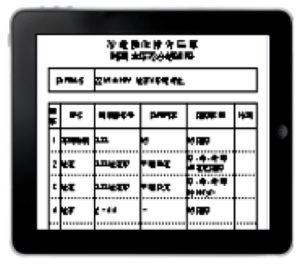
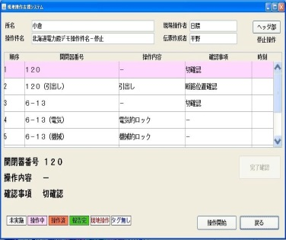

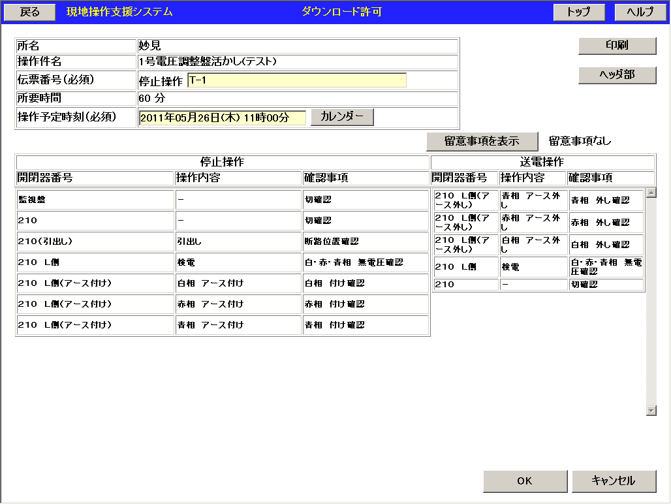
e-slip
Feature
e-slip (Instruction sheet )
No | Function | Effective
1 | Easy input | Saving time to make instruction sheet.
2 | Display instruction with color | Prevention for wrong operation procedure
3 | Voice guidance | Prevention for misrecognition of equipment
4 | Make slip automatically for pair process(Pull/Push, Open/Close etc.) | Prevention for wrong slip creation
5 | Verify slip | Improvement for quality of slip
Instruction sheet of Paper
Display target instruction with color
Make slip automatically for pair process (Pull/Push, Open/Close etc.)
After instruction is finished, this item will be highlighted with some color on e-slip.
For pair process (Pull/ Push, Open/Close, etc.) , prevent wrong slip creation with function that automatically create it.

Slide 11
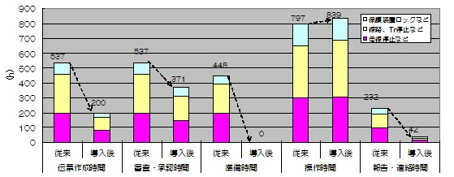
Human Error Analysis
Incident at work
5
Misunderstanding
7
By operation/ Misunderstanding ->ZERO
Incident by operation
11
Note : Average at some Electric Centre
Efficiency for work
Saving time per year
based on one of substation
▲1,102hour
（138workers/day)
Saving time for the followings
1:Making instruction sheets
2:Approval and Examination
3:Preparation time
4:Report/ Communication

Slide 12
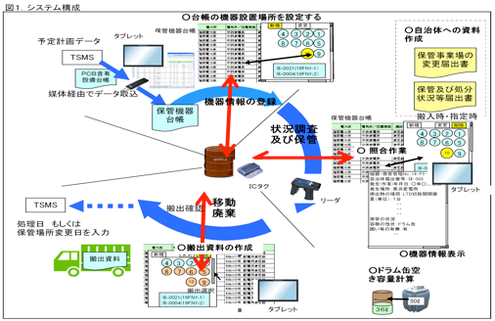
Inventory Management
（PCB management）
Installed on power grid company in Japan
(1) Understanding stock status at short time
(2) Design your favorite layout
Download ledger to the system
Data
Reading on site
Data
Converting the reading data to the reporting format

Slide 13


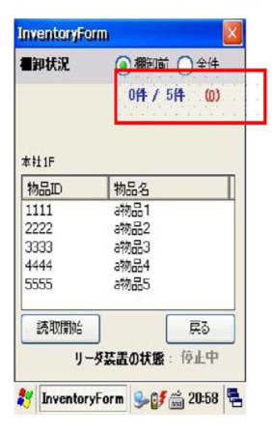



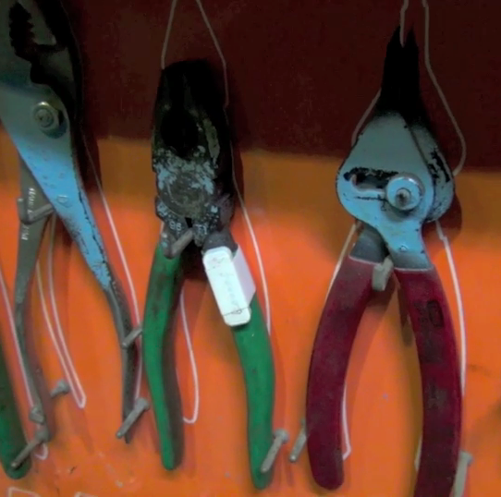
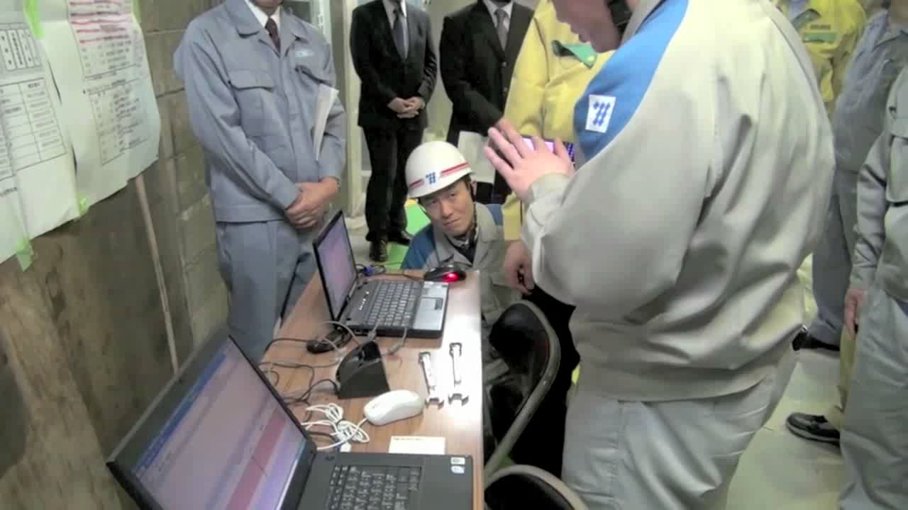
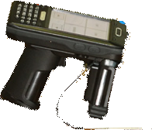
Tool Management
(1)Prevent leaving tools inside electrical equipment and on site for maintenance because of scanning IC tags twice (before work and after work)
(2)Saving time by batch scanning
Checking number of tools
IC Tag
Before work
IC Tag Reader

Slide 14
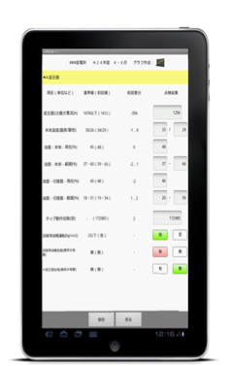
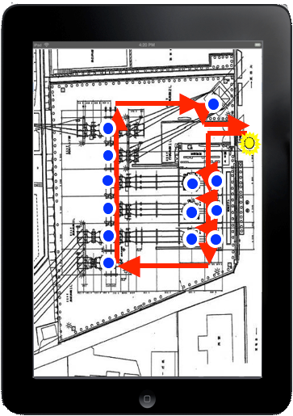
Approaching to Power companies
Navigation system for operation & maintenance
(1)Preventing mistake for target of inspection
(2)Set up inspection routing and prevent omission for inspection work.
Easy to check without errors by anyone.
Contractors
Display route
Active Tag
Note: Detect Active tag from more than 10m.

Slide 15
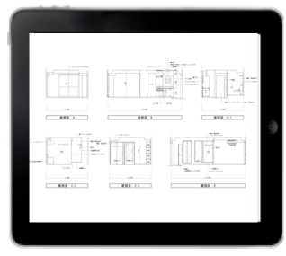

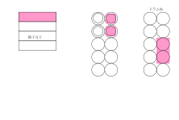
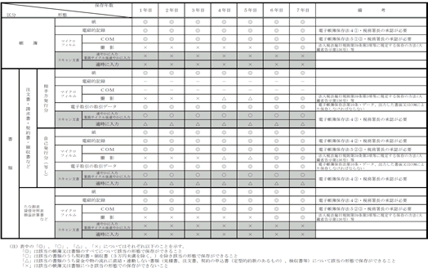
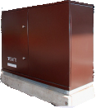


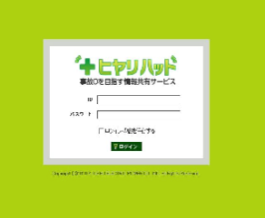
Various solutions with IC Tag
IC Tag will be linked with any kind of data.
Operation procedure
Inventory Management
Maintenance
Inspection
history
Drawing data
Equipment ledger
Reports
Incident history
Tracebility

Slide 16
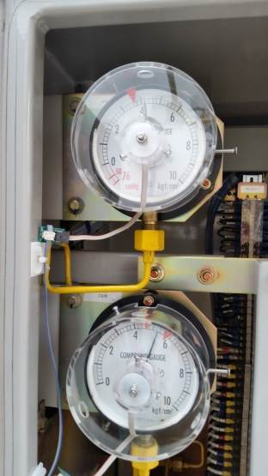







Analog meter monitoring system （Separated type/Integrated type)
[Separate type ]: Separate type sensor for reading the analog pointer on the meter
[Integrated type ]: Integrated type sensor for reading the analog pointer on the meter
[Separated type]
[Integrated type]
Sensor
Antenna
Integrated type
(Wireless/Power, Antenna
, Sensor)
Wireless/Power
[Operation Image]
See the analog meter on the remote location.
The value indicated by the pointer will be changed to the digital value by the sensor.
Anytime, anywhere we can check it. Save a time to go to the remote location.
The sensor for reading the pointer on analog device does not require power source
(Use the battery).
No cabling construction due to wireless. Easy to install and get effect.

